Slide 1




TACTICAL COMBAT CASUALTY CARE COURSE
MODULE 23: DOCUMENTATION
Module 23: Documentation
#TCCC-CPP-PPT-23 08 AUG 23
COMBAT PARAMEDIC/ PROVIDER
TCCC TIER 1
All Service Members
TCCC TIER 2
Combat Lifesaver
TCCC TIER 3
Combat Medic/Corpsman
TCCC TIER 4
Combat Paramedic/Provider

Slide 2




Module 23: Documentation
TACTICAL COMBAT CASUALTY CARE (TCCC) ROLE-BASED TRAINING SPECTRUM
ROLE 1 CARE
NONMEDICAL PERSONNEL
MEDICAL PERSONNEL
YOU ARE HERE
STANDARDIZED JOINT CURRICULUM
#TCCC-CPP-PPT-23 08 AUG 23
2
Notes:
In Module 23 we will discuss the importance of and techniques for documentation of both casualty assessment and the treatment provided in the Tactical Field Care (TFC) phase of Tactical Combat Casualty Care (TCCC).
Tactical Combat Casualty Care is broken up into four roles of care. As a Combat Paramedic/Provider, you are the first medical provider to care for the casualty and initiate more advanced treatments in the continuum of prehospital care. It is important that you understand the roles and responsibilities of the nonmedical personnel (All Service Members and Combat Lifesavers) and other medical personnel (Combat Medics/Corpsmen) who may be assessing, providing care/assisting in the treatment of casualties in the prehospital environment. They may be involved in the documentation of care as well.

Slide 3









Module 23: Documentation
1 x TERMINAL LEARNING OBJECTIVES
25
Given a combat or noncombat scenario, perform documentation of care during Tactical Field Care in accordance with CoTCCC Guidelines.
25.1
Identify how to document casualty information on the DD Form 1380 TCCC Card and the proper placement of that card on the casualty, in accordance with DHA-PI 6040.01.
25.2
Demonstrate the proper documentation of care on a trauma casualty in Tactical Field Care.
Describe the importance and information considerations of a Casualty After Action Report submission.
Demonstrate completion of a Casualty After Action Report.
25.3
25.4
25.5 Identify any evidence-based medicine, best practices, casualty data, and Subject Matter Expert consensus on the strategies and limitations of casualty documentation and data management techniques in Tactical Field Care.
5 x ENABLING LEARNING OBJECTIVES
= Terminal Learning Objectives = Cognitive ELOs = Performance ELOs
#
#TCCC-CPP-PPT-23 08 AUG 23
3
Notes:
There are three cognitive and two performance learning objectives for the Documentation module. The cognitive learning objectives are: identify how to document casualty information on the DD Form 1380 TCCC Card and the proper placement of that card on the casualty, identify the importance and information considerations of a casualty After Action Report submission, and describe the evidence supporting the strategies and limitations of casualty documentation and data management techniques in Tactical Field Care.
The performance learning objectives are to demonstrate the proper documentation of care on a trauma casualty in Tactical Field Care and demonstrate the completion of an After Action Report.

Slide 4

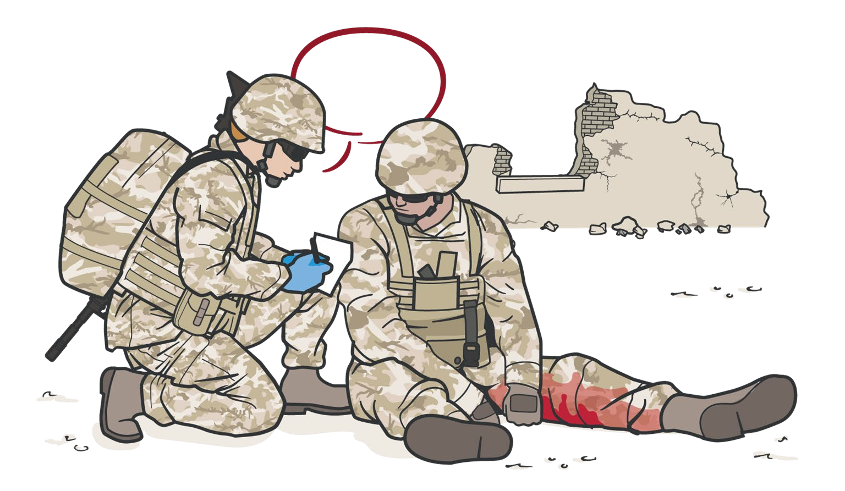
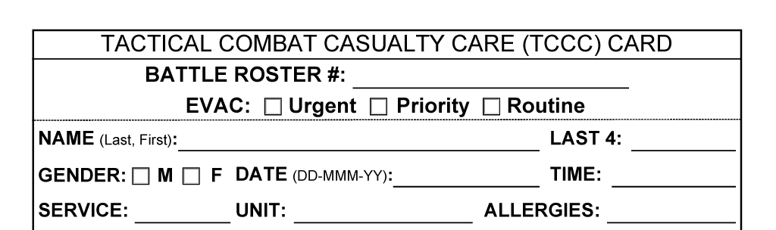

IMPORTANCE
OF DOCUMENTATION
Module 23: Documentation
Documentation directly impacts ongoing casualty care
Information is crucial to other providers in the continuum of care
Prehospital documentation becomes
a permanent part of the casualty’s longitudinal medical record
Data informs casualty care process improvement
REMEMBER Documentation of care on the battlefield is not simply an administrative requirement
Notes:
Documentation of care on the battlefield is not just an administrative requirement. It provides crucial information to other providers in the continuum of care that informs further assessment and treatment. The casualty’s level of consciousness and vital signs, when a tourniquet was applied, and if and when analgesics or tranexamic acid (TXA) were administered are examples of information that might directly impact ongoing casualty care.
Prehospital documentation becomes part of the casualty’s longitudinal medical record, permanently recording injuries and wounds sustained and the care provided.
Furthermore, the care and outcomes data captured in prehospital documentation becomes part of the Department of Defense (DoD) Trauma Registry, informs evidence-based combat casualty care process improvement, and helps to shape the future of battlefield trauma care.¹

Slide 5








Module 23: Documentation
CHALLENGES
IN DOCUMENTING CARE
TIME CONSTRAINTS
TASK SATURATION
(multiple casualties, etc.)
TACTICAL SITUATION
ENVIRONMENTAL CONSTRAINTS
(low light, weather, etc.)
REMEMBER You have not finished caring for a casualty until you have documented the care
Notes:
Despite the importance of recording the prehospital combat casualty care provided, analysis of data from the US Military’s experience in Iraq and Afghanistan over a six-year period from 2001 to 2007 revealed that less than 10 percent of casualties had documentation of the care that was provided before the casualty reached a medical treatment facility.²
The numerous challenges in documenting battlefield casualty care are well established. The first responders, Combat Medics/Corpsmen, and Combat Paramedic Providers who are responsible for documentation are often task saturated caring for multiple casualties and preparing casualties for evacuation while continuing to support the unit’s primary mission. They frequently face significant time, environmental, and tactical constraints in the prehospital environment that make real-time documentation of casualty assessment and the care provided difficult at best.³ Documentation is often an afterthought completed only when time is available and the situation permits.
It is important to remember that you have not finished caring for a casualty until you have properly documented the care.

Slide 6

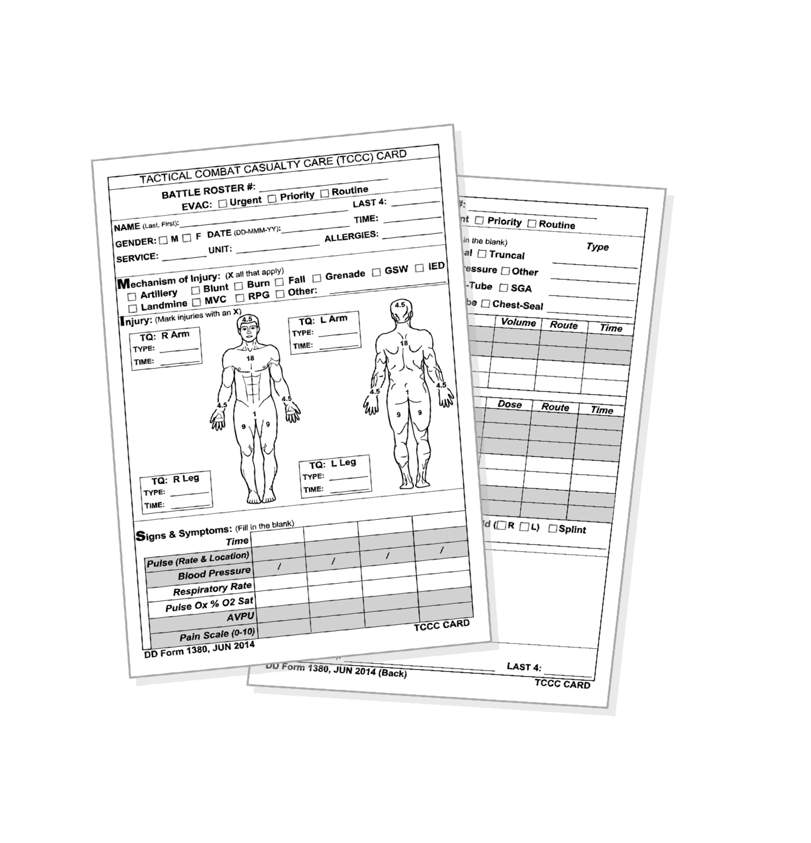



DD FORM 1380
TACTICAL COMBAT CASUALTY CARE (TCCC) CARD
Module 23: Documentation
Principles of DD Form 1380 Completion | Commonly Missed Areas on the DD Form 1380
Use the casualty’s TCCC Card Found in the Joint First Aid Kit | Medication: Dose, Route, Time, Type, etc.
Completed by WHOEVER is providing care at point of wounding | Tourniquets: Application Time & Type Initial placement, replacement, and conversion
Updated by all subsequent prehospital providers | Vital Signs: Baseline and Trends
Attached to the casualty and handed off during evacuation to next higher level of care | First Responder Information: at the bottom of the card Name (Last, First) and Last four SSN
Notes:
In many instances, the first responders providing prehospital care at the point of wounding are not medical providers. Documentation of care by nonmedical personnel as well as medical personnel requires a format that can be easily understood and used effectively.
All findings and medical treatments (including interventions and medications) performed should be documented on the casualty’s Tactical Combat Casualty Care Card (DD Form 1380) which can be found in the Joint First Aid Kit (JFAK).^{4, 5, 6}
The card was designed by medics based on the principles of TCCC, includes only essential information, and addresses initial lifesaving care. The card is easy to use and can be filled out in less than 2 minutes.⁷ Best practice is for units to ensure that each Service member prepopulates the top portion (casualty demographics) of their TCCC Card to facilitate timely and accurate documentation.
Documentation on the TCCC Card should be completed by whoever is providing care at the point of injury or wounding and updated with any changes in the casualty’s status or additional care rendered by all subsequent prehospital providers.
After appropriate documentation has been completed, the TCCC Card (DD Form 1380) should be attached to the casualty in a visible location and handed off during evacuation to the next higher level in the prehospital care continuum. The TCCC Card will become a permanent part of the Service member’s longitudinal medical record.
Kotwal, et al. described how data from prehospital combat casualty care documented on casualty care cards was collected in a unit trauma registry and used for near real-time evidence-based process improvement. The results of that landmark study showed that the 75th Ranger Regiment was able to nearly eliminate preventable prehospital trauma deaths, drove standardization of the use of what is now the DD Form 1380 Combat Casualty Care Card, and has informed consensus guidelines regarding prehospital documentation.

Slide 7


Module 23: Documentation
DD FORM 1380
Video can be found on deployedmedicine.com
Notes:
The following video demonstrates the use of the DD Form 1380 (TCCC Card).
Remember that the casualty’s TCCC Card, found in the JFAK, should be used by whoever is providing care at the point of injury to document all findings and treatments rendered.

Slide 8

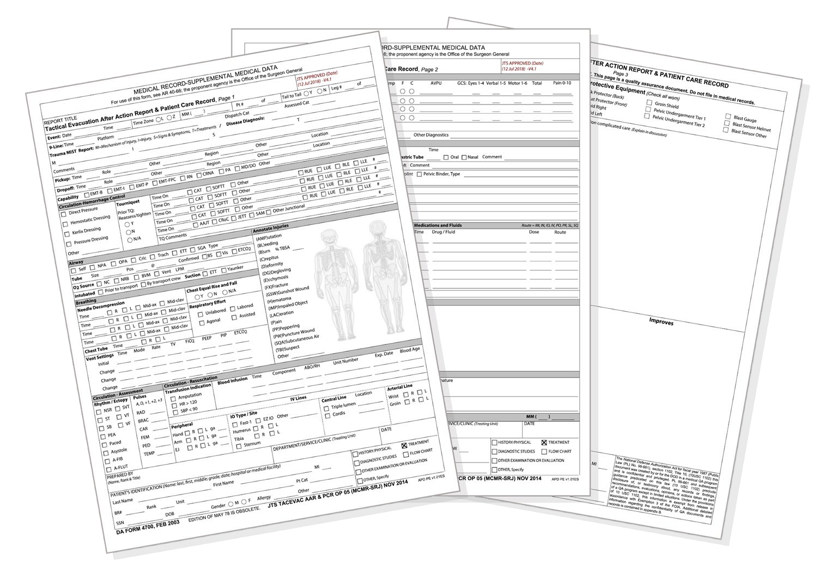
Module 23: Documentation
TACTICAL COMBAT CASUALTY CARE (TCCC) AFTER ACTION REPORT (AAR)
This electronic AAR is intended to be completed after the first responder completes the mission and returns to base
It is a more detailed and complete record of the care provided than the TCCC Card
Completed by unit CMC or CPP and submitted electronically via the Joint Trauma System website within 72 hours
Both the TCCC Card and the TCCC AAR are required for optimal care documentation
Notes:
Due to the constraints of the prehospital environment, care cannot always be documented or completely documented in real-time on the TCCC Card (DD Form 1380). Accordingly, care should be documented and/or supplemented retrospectively by whoever rendered the care utilizing the TCCC After Action Report (AAR).
The TCCC AAR process is described in the literature (lower quality retrospective observational evidence) and supported by expert consensus guidelines.^{8, 9}
The electronic AAR is intended to be completed by whoever rendered the care after the first responder or CMC/CPP completes the mission and returns to base. It is a more detailed and complete record of the care provided than the TCCC Card. It is completed by or with (in the case of a nonmedical first responder) the unit CMC/CPP and submitted electronically via the Joint Trauma System (JTS) website within 72 hours following the mission. Both the TCCC Card and the TCCC AAR are required for optimal documentation of prehospital care.
The evidence supporting the documentation strategies in Tactical Field Care is variable. That said, it is clear from the literature that without documentation of prehospital combat casualty care “we would not know what we do not know” making evidence-based process improvement in prehospital combat casualty care impossible.¹⁰ The use of both the TCCC Card and the TCCC After Action Report is reflected in guidelines informed by subject matter expert consensus.¹¹
Additionally, retrospective reviews and observational studies have provided a moderate level and quality of evidence supporting the role of the Tactical Combat Casualty Care Card (DD 1380)¹² and some lower level and quality of evidence supporting the role of the TCCC After Action Report¹³ in informing evidence-based process improvement and reduction of preventable prehospital deaths.
The LOE denotes the confidence in or certainty of the evidence supporting the recommendation, based on the type, size, quality, and consistency of pertinent research findings.¹⁴
Why the AHA Classification System?
The level of evidence recommendations allow readers to quickly glean information on the strength, certainty, and quality of evidence supporting each recommendation.
A recommendation with level of evidence C does not imply that the recommendation is weak. Many important clinical questions addressed in guidelines do not lend themselves to clinical trials. Although, RCTs are unavailable, there may be a very clear clinical consensus that a particular test or therapy is useful or effective.
Evidence-based recommendations and guidance is the result of a careful review of studies and discussion by a panel of subject matter experts. For TCCC, the subject matter expert panels include both Committee on TCCC members, and select invited subject matter experts from within both the military and civilian community, based on the specific interest area.
A common approach is the Grading of Recommendations Assessment, Development, and Evaluation (GRADE) system,¹⁵ which rates the quality of evidence, then balances that with the outcomes (desirable and undesirable) to provide a recommendation with a comment about the certainty of the evidence. But there are other similar methodologies used by professional organizations, as well.
The quality of the evidence looks at variables like the number of studies on the area of interest, any limitations of the study, biases, consistencies, sample sizes, and statistical strengths of the results, among other things. In general, randomized, controlled studies with statistically significant findings are graded higher and observational studies with equivocal to mildly significant findings are graded lower. And consensus subject matter expert opinions without observational (or randomized) studies are also graded lower.
But keep in mind, that in the absence of clear evidence from formal studies, the use of consensus opinions is considered a best practice, which should be accompanied by simultaneous research to study that area of interest and ultimately provide evidence to support that opinion or alter the recommendation.
The following skill cards will help you practice documentation of Tactical Combat Casualty Care utilizing the DD Form 1380 (TCCC Card) and the TCCC After Action Report (AAR).
Remember, completion of both the TCCC Card and the TCCC AAR is required for optimal documentation of prehospital care.

Slide 9

SKILL STATION
Module 23: Documentation
Documentation (skills)
DD Form 1380 (TCCC Card) TCCC After Action Report (AAR)
Notes:
The following skill cards will help you practice documentation of Tactical Combat Casualty Care utilizing the DD Form 1380 (TCCC Card) and the TCCC After Action Report (AAR).
Remember, completion of both the TCCC Card and the TCCC AAR is required for optimal documentation of prehospital care.

Slide 10
SUMMARY
Module 23: Documentation
Knowledge Topics
Proper placement and completion of casualty information on DD Form 1380
Importance and information considerations for casualty AAR submission
Skills and Abilities
Completion of the TCCC DD Form 1380
Completion of the TCCC After Action Report (AAR)
Notes:
Documentation of care on the battlefield is not just an administrative requirement. It provides crucial information to other providers in the continuum of care that informs further assessment and treatment and might directly impact ongoing casualty care.
Prehospital documentation becomes part of the casualty’s longitudinal medical record, permanently recording injuries and wounds sustained and the care provided. Furthermore, the care and outcomes data captured in prehospital documentation becomes part of the Department of Defense (DoD) Trauma Registry, informs evidence-based combat casualty care process improvement, and helps to shape the future of battlefield trauma care.
Remember, you have not finished caring for a casualty until you have documented the care rendered. Document all findings, interventions, and treatments on the DD Form 1380 TCCC Card in real-time.
If real-time documentation is not possible due to the constraints of the battlefield environment, document retrospectively using the TCCC After Action Report.

Slide 11

CHECK ON LEARNING
Module 23: Documentation
Why is it important to document prehospital combat casualty care?
What is the difference between the TCCC Card
(DD Form 1380) and the TCCC After Action Report (AAR)?
TRUE or FALSE?
Only the Combat Medic/Corpsman can document prehospital care for a casualty using the TCCC Card (DD Form 1380)?
Notes:
To close out this module, check your learning with the questions below (answers under the image).
Answers
Why is it important to document prehospital combat casualty care?
Documentation of care on the battlefield is not just an administrative requirement.
It provides crucial information to other providers in the continuum of care that informs further assessment and treatment.
The casualty’s level of consciousness and vital signs, when a tourniquet was applied, and if and when analgesics or TXA were administered are examples of information that might directly impact ongoing casualty care.
Prehospital documentation becomes part of the casualty’s longitudinal medical record, permanently recording injuries and wounds sustained and the care provided.
Furthermore, the care and outcomes data captured in prehospital documentation informs evidence-based combat casualty care process improvement and helps shape the future of battlefield trauma care.
What is the difference between the TCCC Card (DD Form 1380) and the TCCC After Action Report (AAR)?
TCCC Card (DD Form 1380)
The TCCC Card (DD Form 1380) is filled out in real-time (when assessments are completed and care is rendered) by whoever is providing the care at point of wounding or injury.
The card may be filled out by nonmedical personnel or a Combat Medic/Corpsman.
After appropriate documentation has been completed, the TCCC Card (DD Form 1380) should be attached to the casualty in a visible location and handed off during evacuation to the next higher level in the prehospital care continuum.
The TCCC Card will become a permanent part of the Service member’s longitudinal medical record.
TCCC After Action Report (AAR)
The TCCC After Action Report is completed retrospectively after the mission is complete and the first responder has returned to base.
This electronic AAR is intended to be completed by whoever rendered the care after the first responder or Combat Medic/Corpsman completes the mission.
It is a more detailed and complete record of the care provided than the TCCC Card.
It is completed by or with (in the case of a nonmedical first responder) the unit Combat Medic/Corpsman and submitted electronically by the Combat Medic/Corpsman via the Joint Trauma System website within 72 hours following the mission.
True or False: Only the Combat Medic/Corpsman can document prehospital care for a casualty using the TCCC Card (DD Form 1380).
False. Documentation on the TCCC Card (DD Form 1380) should be completed by whoever is providing care at the point of injury or wounding and updated with any changes in the casualty’s status or additional care rendered by all subsequent prehospital providers.
Documentation can be completed by nonmedical personnel or the Combat Medic/Corpsman.

Slide 12




Module 23: Documentation
ANY QUESTIONS?

Slide 13

REFERENCES
Module 23: Documentation
TCCC: Guidelines
by JTS/CoTCCC
These guidelines, updated regularly, are the result of decisions made by CoTCCC in exploring evidence-based research on best practices.
PHTLS: Military Edition, Chapter 25
by NAEMT
Prehospital Trauma Life Support (PHTLS), Military Edition, teaches and reinforces the principles of rapidly assessing a trauma patient using an orderly approach.
Notes:
¹ Kotwal R, Montgomery H, Kotwal B, Champion H, Butler F, Mabry R, Cain J, Blackbourne L, Mechler K, Holcombe J. Eliminating Preventable Death on the Battlefield. Arch Surg. 2011; 146(12): 1350-1358.
² Eastridge B, Mabry R, Seguin P, et al. Death on the Battlefield (2001-2011): Implications for the Future of Combat Casualty Care. J Trauma Acute Care Surg. 2012;73(6)(suppl 5):S431-S437.
³ Eastridge B, Mabry R, Blackbourne L, Butler F. We Don’t Know What We Don’t Know: Prehospital Data in Combat Casualty Care. US Army Med Dept J. 2011:11-14.
⁴ Prior reference 1.
⁵ Kotwal R, et al. The Tactical Combat Casualty Care Casualty Card TCCC Guidelines Proposed Change-1301. J of Special Operations Medicine. Apr 2013; 13(2): 82-87.
⁶ Selby D, Eickhoff E, Remley M, et all. Joint Trauma System Clinical Practice Guideline Documentation Requirements for Combat Casualty Care (CPG ID: 11). Updated 18 Sep 2020.
⁷ Therien S, Andrews J, Nesbitt M, Mabry R. An Observational Study Assessing Completion Time and Accuracy of Completing the Tactical Combat Casualty Care Card by Combat Medic Trainees. J of Special Operations Medicine. 2014; 14(2): 38-45.
⁸ Robinson J, Smith M, Gross K, Sauer S, Geracci, J, Day C, Kotwal R. Battlefield Documentation of Tactical Combat Casualty Care in Afghanistan. U.S. Army Medical Department Journal. Apr-Sep 2016: 87-89.
⁹ Prior reference 6.
¹⁰ Prior reference 3.
¹¹ Prior reference 6.
¹² Prior references 1 and 5.
¹³ Prior reference 8.
¹⁴ Halparin, JL. Further Evolution of the ACC/AHA Clinical Practice Guideline Recommendation Classification System. American College of Cardiology Foundation and the American Heart Association. 2016 Apr; 133:1426-1428.
¹⁵ Guyatt G, et al. GRADE guidelines: 1. Introduction – GRADE evidence profiles and summary of findings tables. J Clinical Epidemiology. 64(2011):383-394.

